Slide 1

Programming For Graphics
Lights

Slide 2
Radiometry

Slide 3


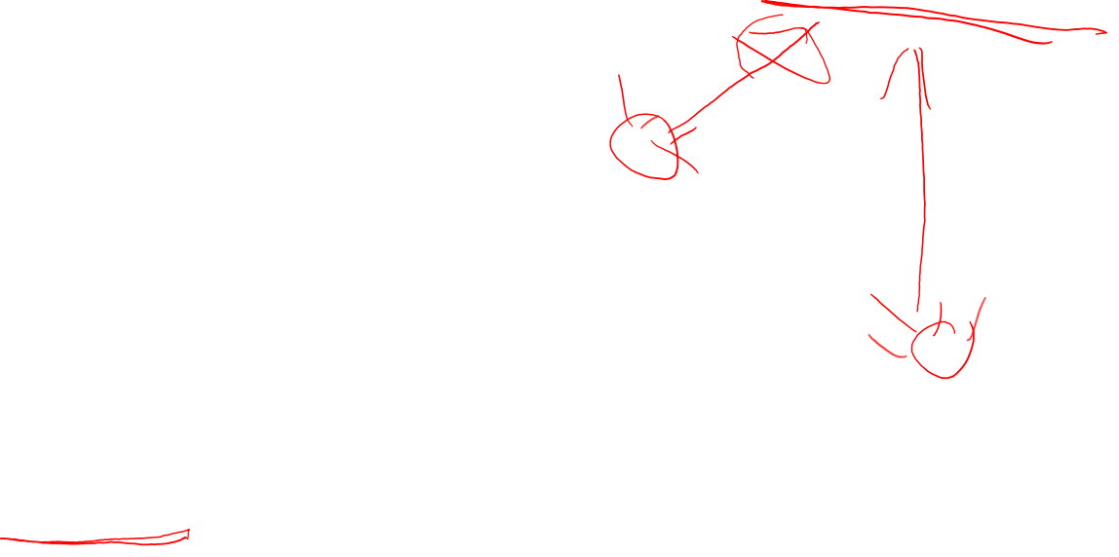
Radiometry
We measure light power in units of Radiant Flux
Watts or Joules per second
No use to us as result is ambiguous.
Are we seeing a lot of light on a small surface
Or
A little light on a large surface?
Irradiance is the amount of power per unit surface area
E $=[W/m^{2}]$
Still ambiguous
Is it a lot of energy at a huge angle
Or
A little energy over a small angle?

Slide 4
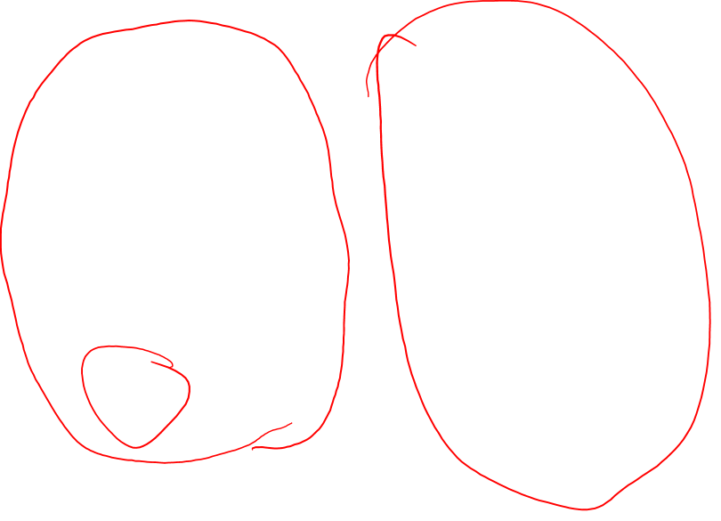
Where's the light?

Slide 5
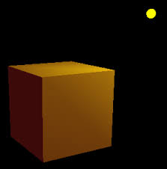
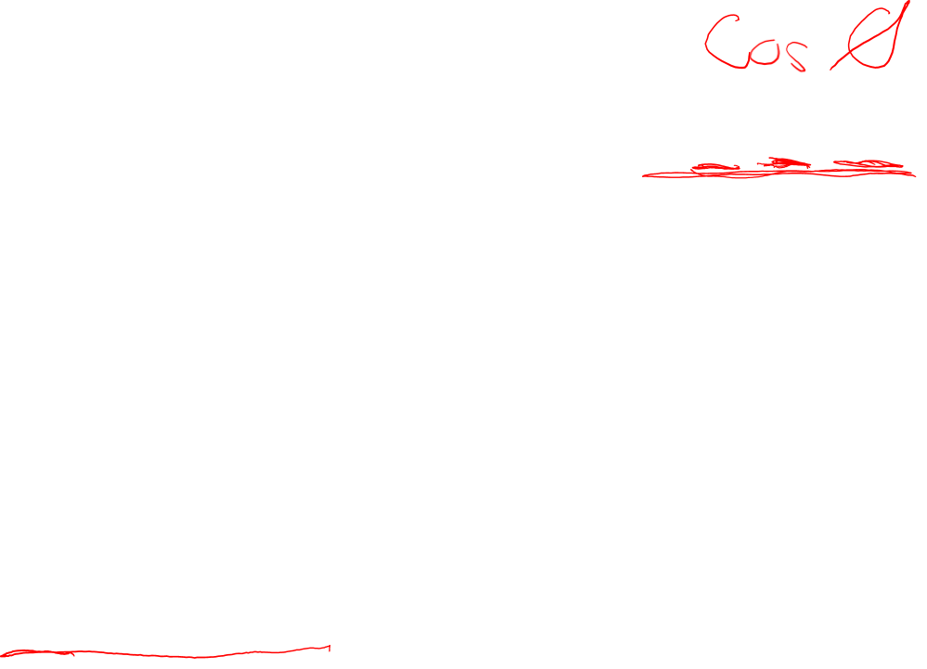

Radiometry
We need to take the angle of the surface in to account.
We call this Radiance.
L $=[W/\left\langle m^{2}∗SR\right\rangle ]$
SR is the angle of the surface, relative to the light.
In space with more than 2 dimensions, we call this Steradian
https://en.wikipedia.org/wiki/Steradian
Steradian: if you want to know more.
Do you need them?
Might be useful one day but today, you can get by just fine with dot products and cosines.

Slide 6
Lights

Slide 7
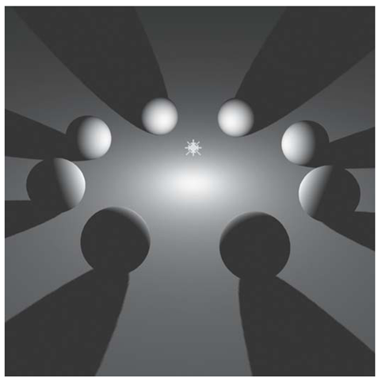
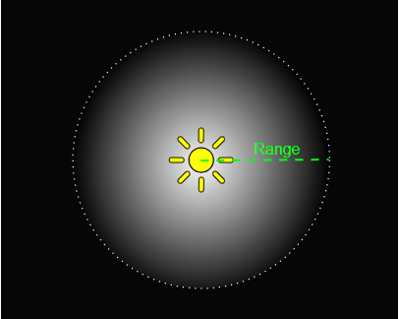
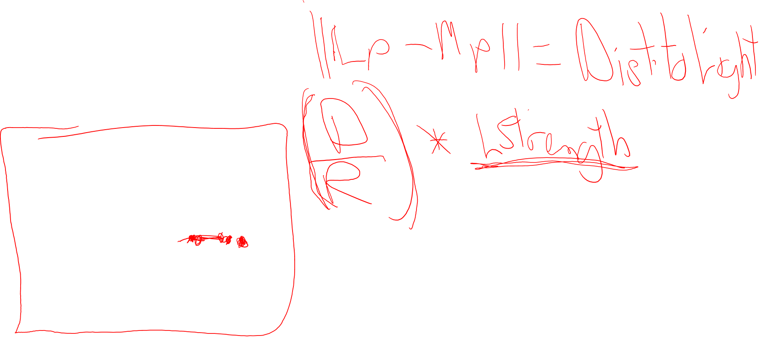
Points Lights

Slide 8
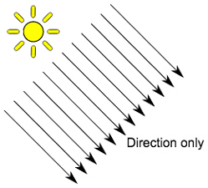
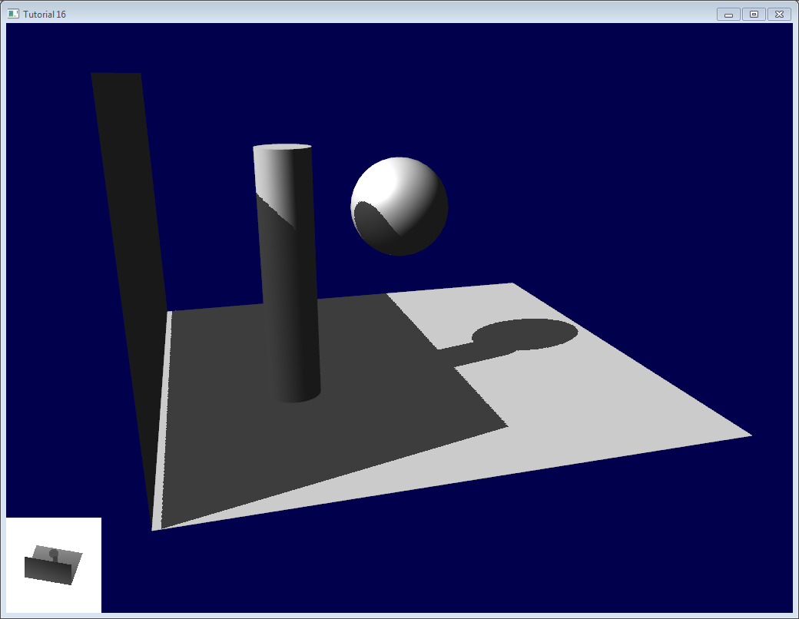
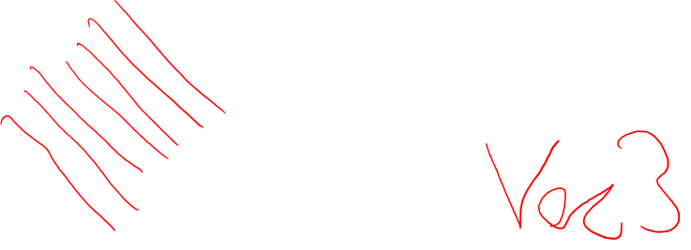
Directional lights

Slide 9
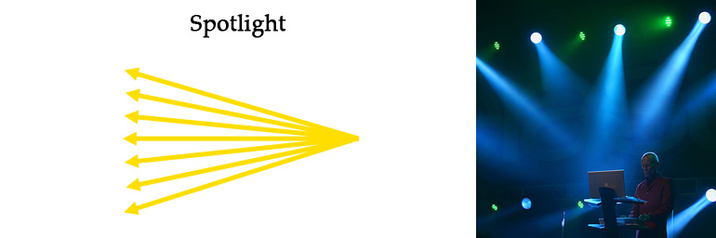

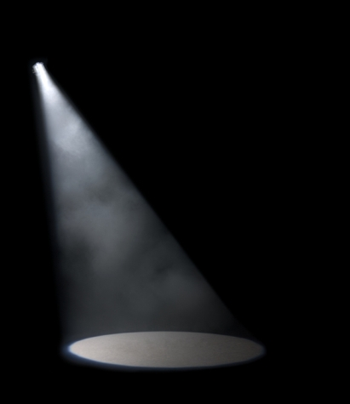
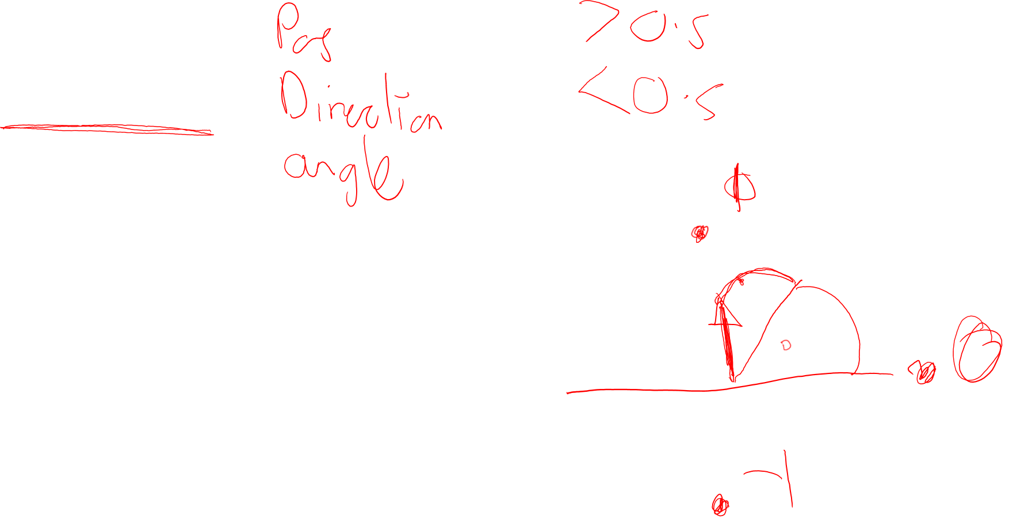
Spot Lights

Slide 10

BRDF & BTDF
Bidirectional Reflection Distribution Function
Bidirectional Transmission Distribution Function

Slide 11
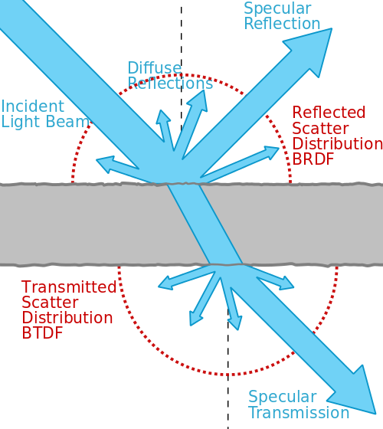
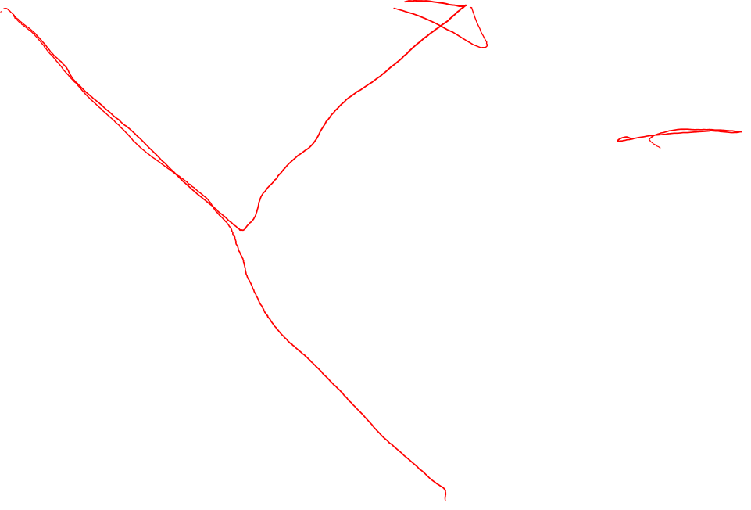
Bxdf
Some times abbreviated to BxDF
Where X is either reflection or transmittance.
Refers to functions that describe how to reflect or transmit light.

Slide 12
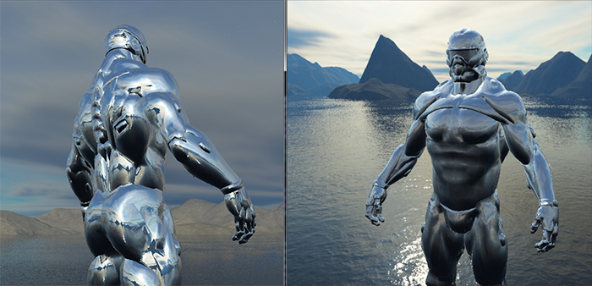

Reflection
The amount of radiant flux returned by the surface.
Measured in Radiance as the surface size and angle are important.
There are two main types of reflation:
Diffuse
Specular

Slide 13
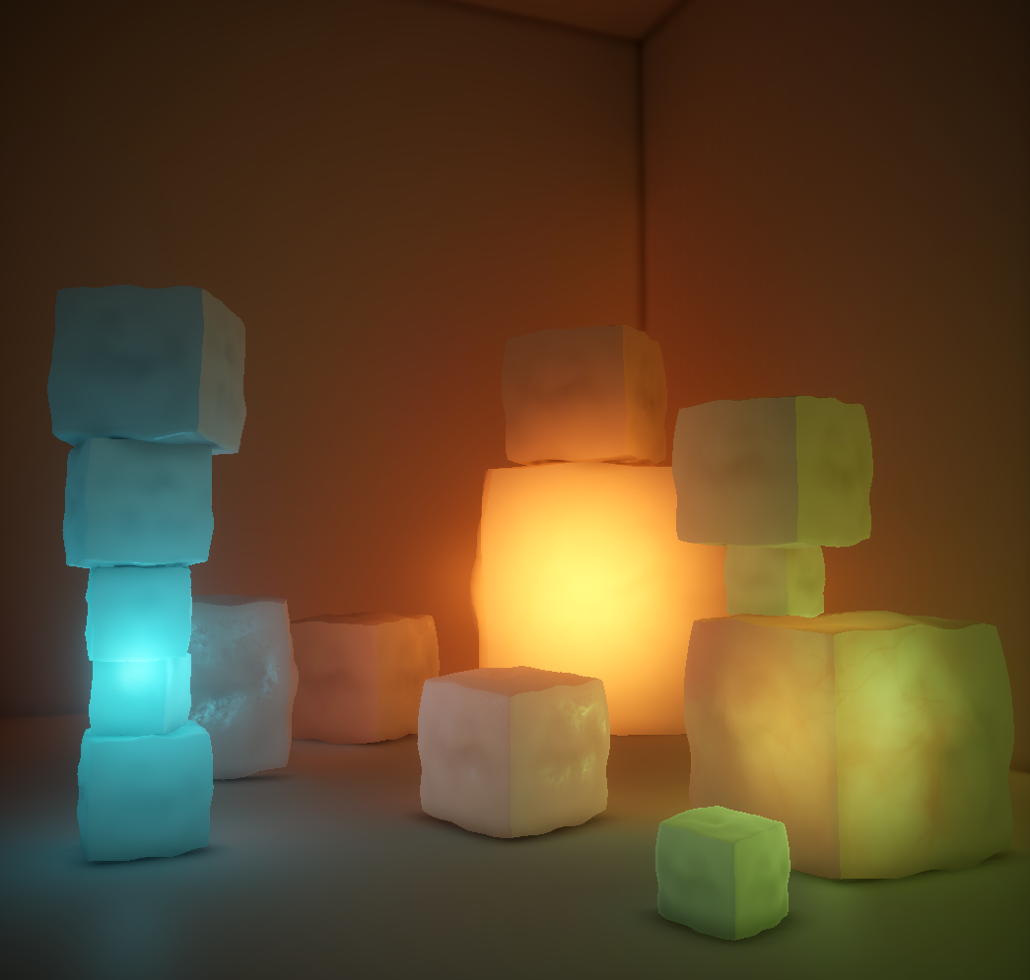
Transmittance
How light passes through a surface.
(we wont be doing anything with this but its still good to know about).

Slide 14
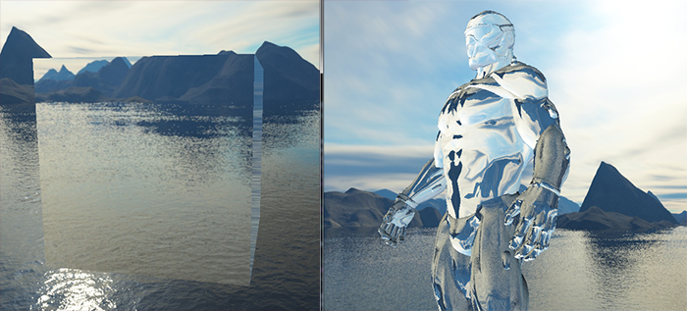
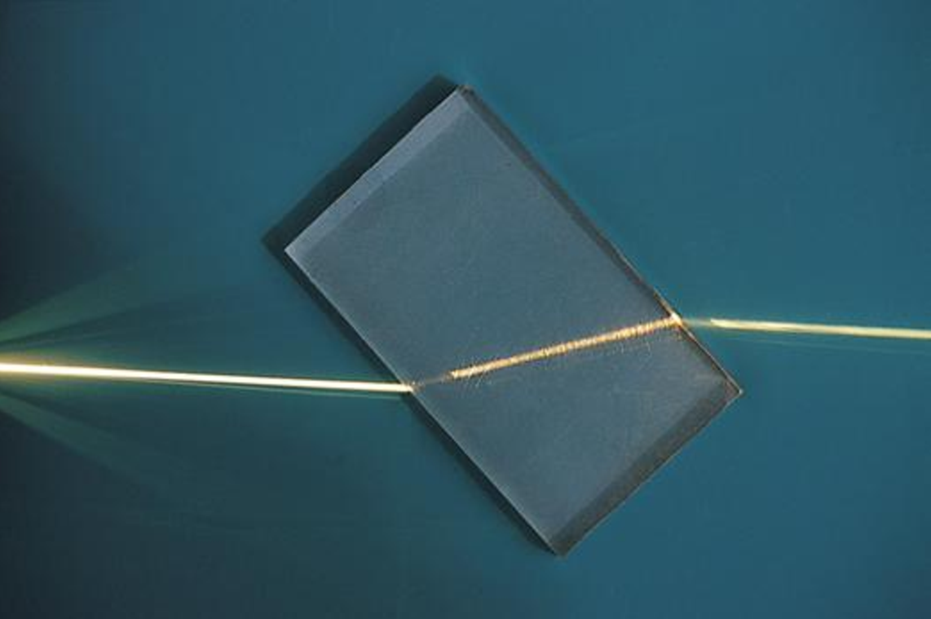

Refraction
The change in direction of light as it passes from one medium to another.

Slide 15
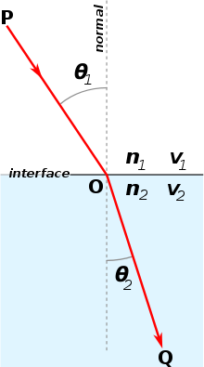
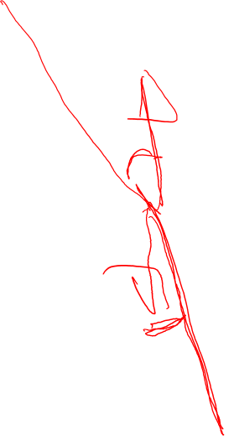

Snell’s Law
$\frac{\sin{θ_{2}}}{\sin{θ_{1}}}=\frac{v_{2}}{v_{1}}$ = $\frac{n_{1}}{n_{2}}$
Describes the relationship between the angle of incidence (incoming light) and its refraction through a medium.
The ratio of sines
=
the ratio of phase velocities
=
the reciprocal of the ratio of the indices of refraction.

Slide 16
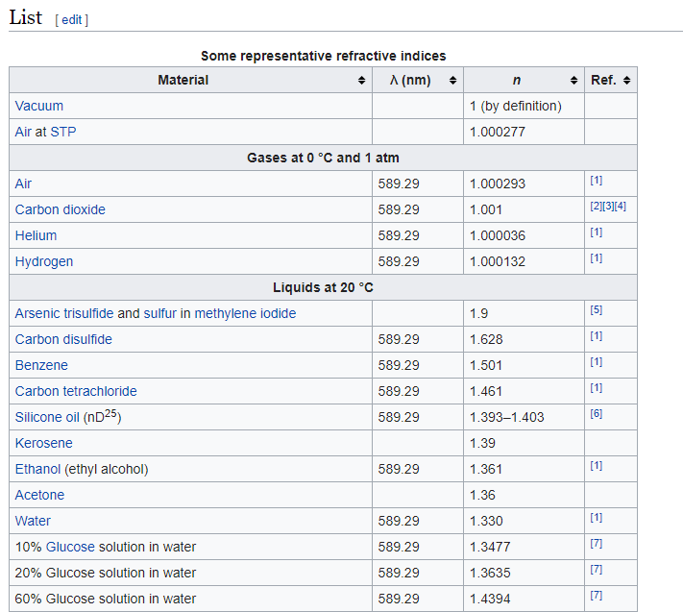

Example of refraction indices
These values have already been calculated for you, for many mediums.
Just look them up.
https://en.wikipedia.org/wiki/List_of_refractive_indices

Slide 17
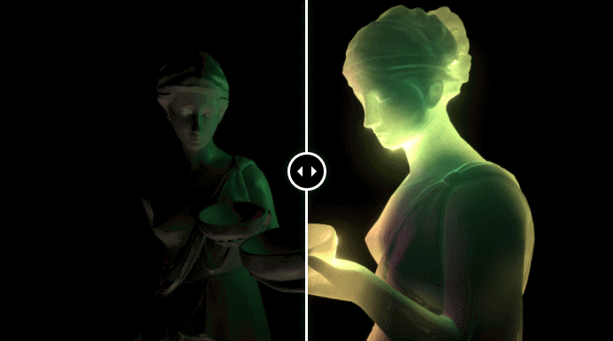
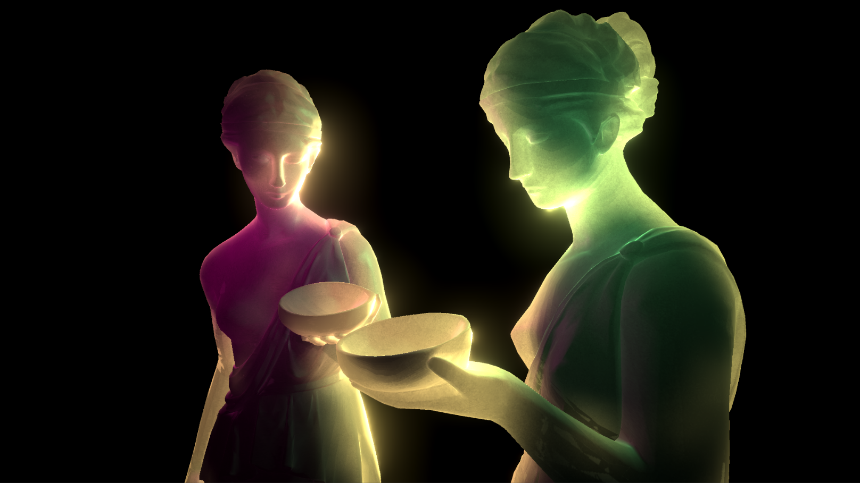
Sub surface scattering (SSS)
Models how light is transmitted through translucent materials.
Some light is allowed to pass through.
Some light is absorbed internally.
Some light is reflected internally.
Light might take on the colour of the material.

Slide 18
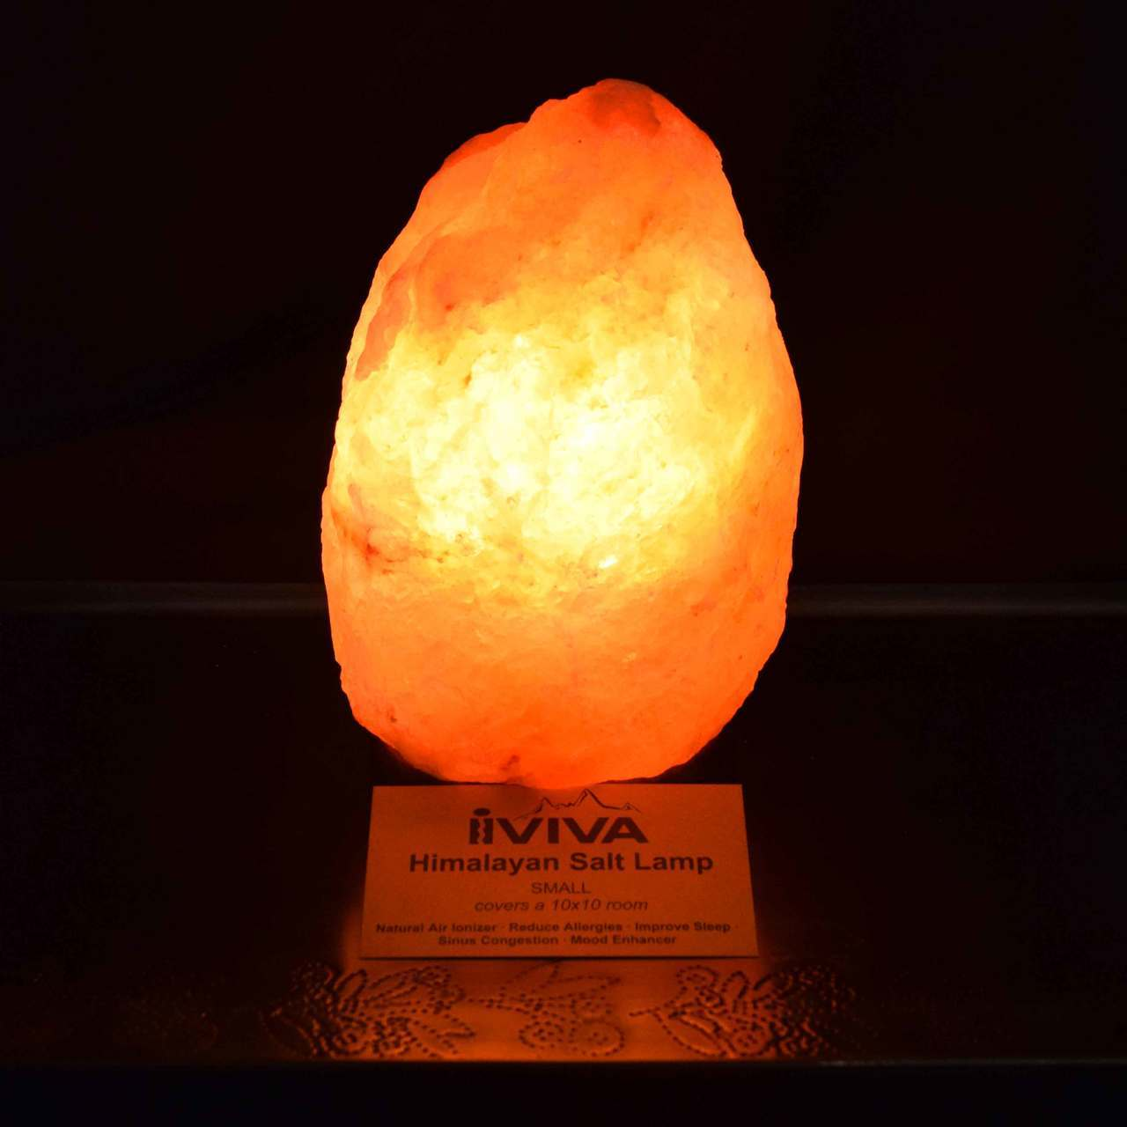
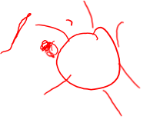
SSS in real life

Slide 19
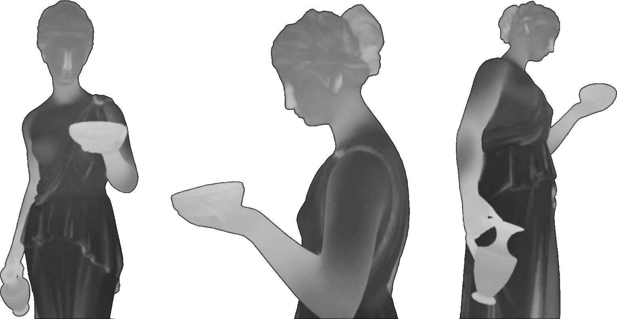
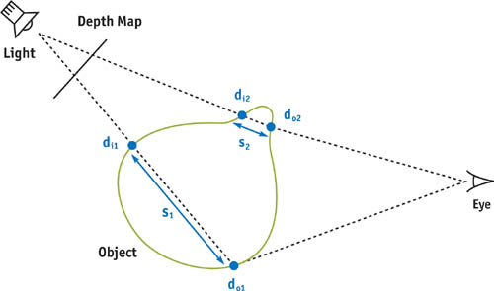
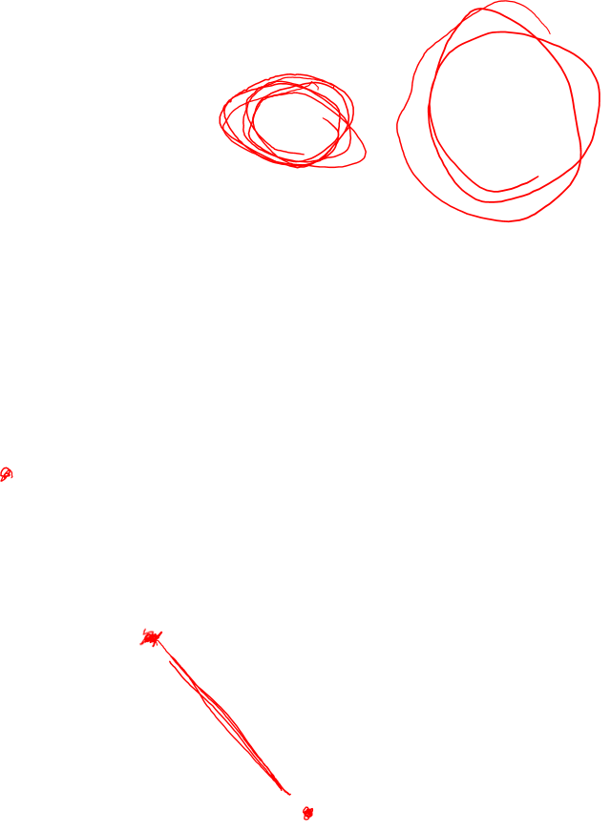
Sub surface scattering with depth map
In order for SSS to work, we need to know the thickness of the object, relative to our view angle.
A ‘thickness map’ can be computed based on the distance of the fragments on one side of the object, to the other.
This map is calculated by finding the difference (in world space) from the depth map of the light, to the depth map of the camera.
Depth maps will be covered in later lessons.

Slide 20
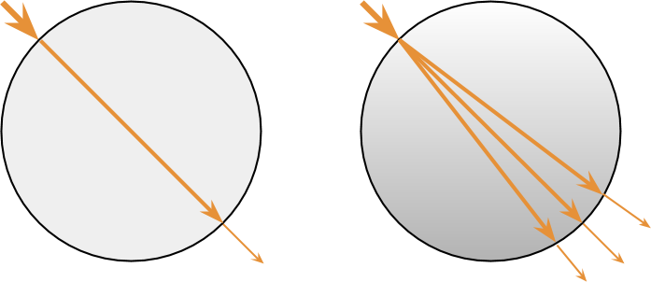
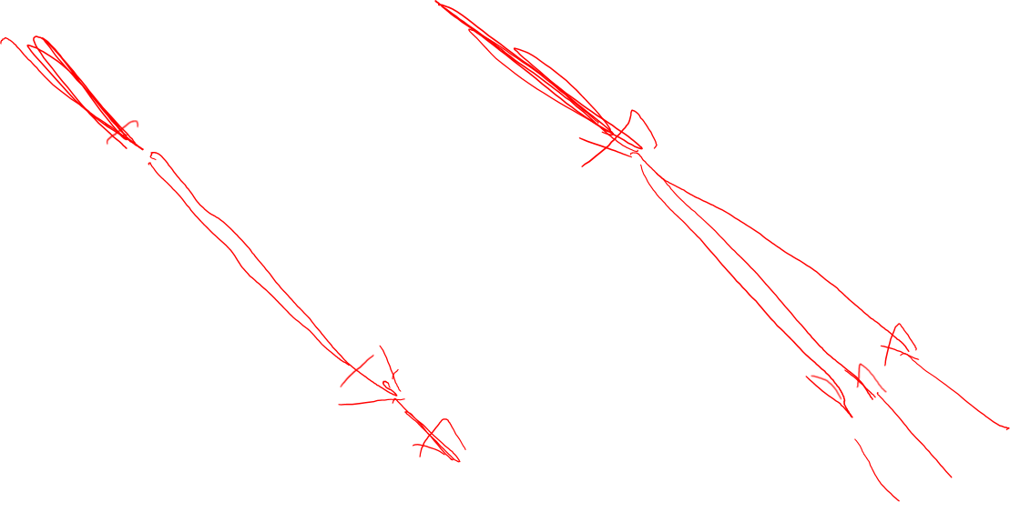
Translucent and transparent
Transparent materials affect the amount of light passing through a material.
Translucent materials affect the direction of the light.
How much the lights direction and power are altered by is the out put of the BTDF

Slide 21
Simple lights iN OPenGL

Slide 22
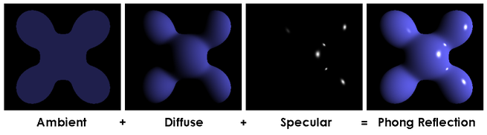
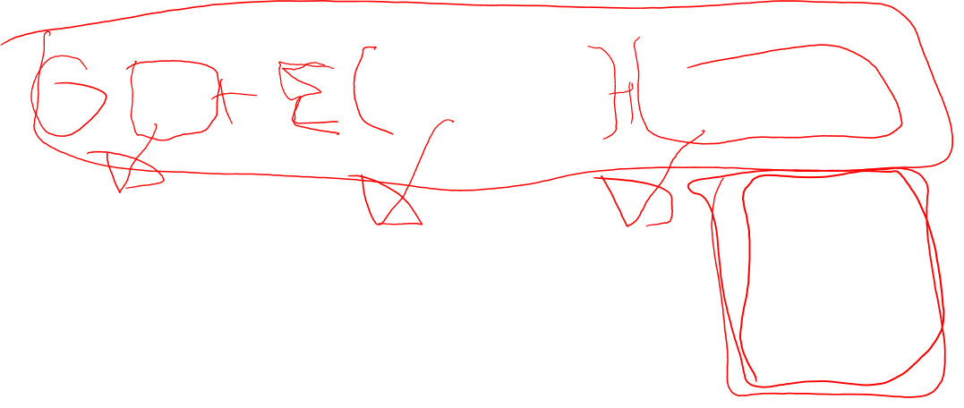

Pong Lighting
$$I_{P}= k_{a}i_{a}+ \sum_{m ∈Lights}{(k_{d}\left({\hat{L}}_{m}∙ \hat{N}\right)i_{m,d}+ k_{s}{({\hat{R}}_{m}∙ \hat{V})}^{α}i_{m,s})}$$
A BRDF

Slide 23

Assumptions
Our light will be a point light
So all light directions will be: lightPos – FragPos.
The light will be white.
The light will have no fall off over distance.

Slide 24

Ambient
Light that doesn’t come from any particular direction.
Even lighting, in all directions.
Object could be seen as being self illuminating.
This is not actuate lighting but it helps improve global illumination of a scene, and is not as computationally expensive as other techniques.

Slide 25
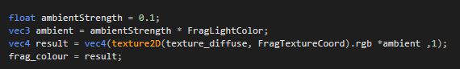
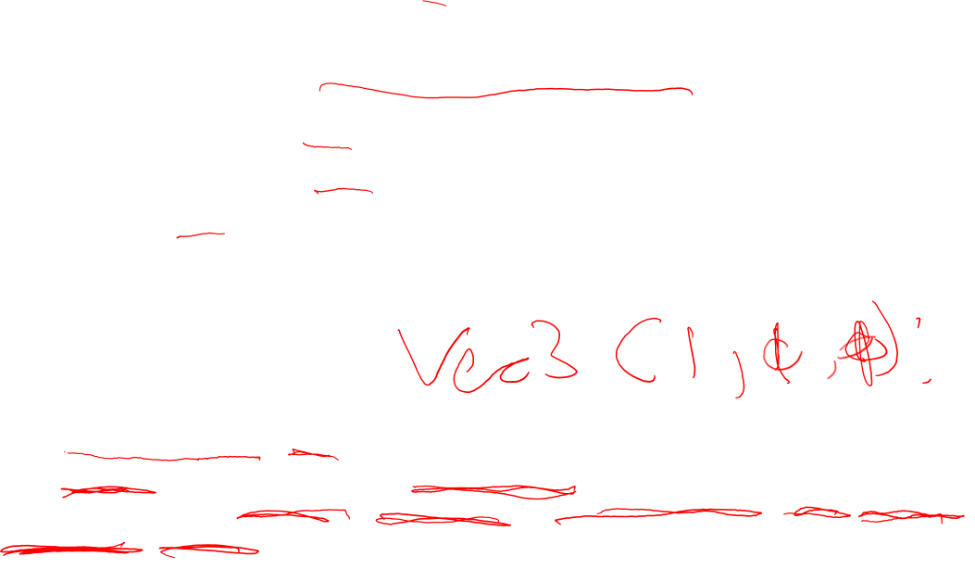

Ambient math
$$I_{AP}= k_{a}i_{a}m_{a}$$
Ambient Frag Colour = Light Luminance * Light Colour *material (texture or mesh) colour

Slide 26
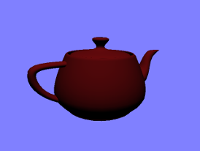
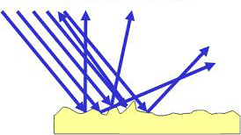
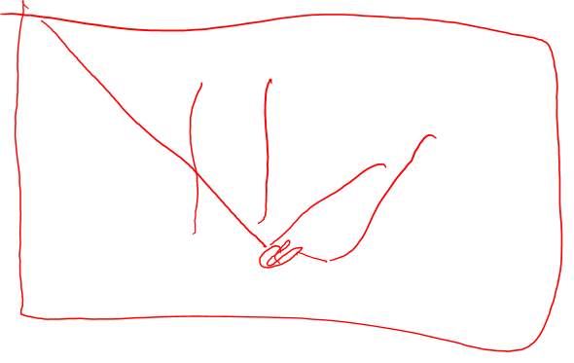
Diffuse
Mimics microscopic irregularities in the surface.
Light is reflected but in all directions and thus image is not formed.
Incoming Light
Diffuse Reflection

Slide 27
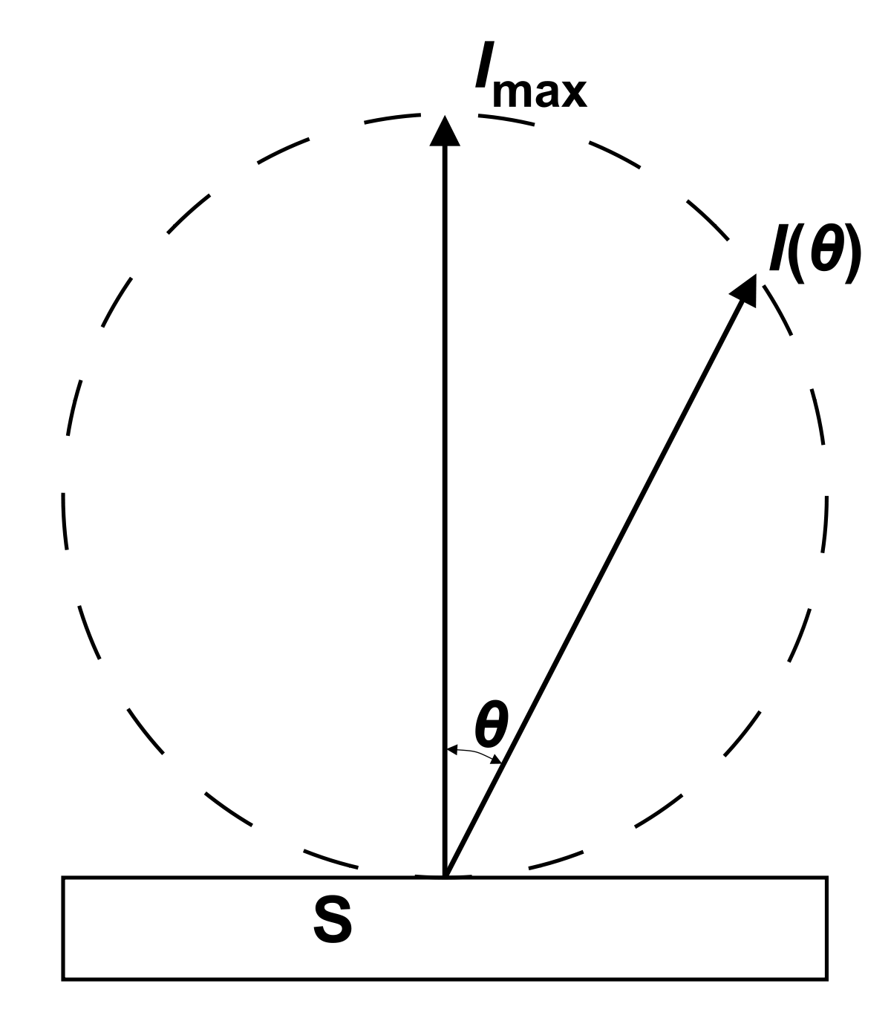
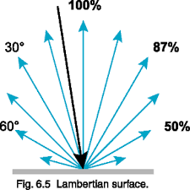
Lambert’s cosine law
The law describes a surface with an ideal diffuse reflection.
The reflection is directly proportional to the cosine of the angle between the incident light and the surface normal.

Slide 28
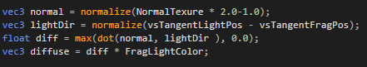
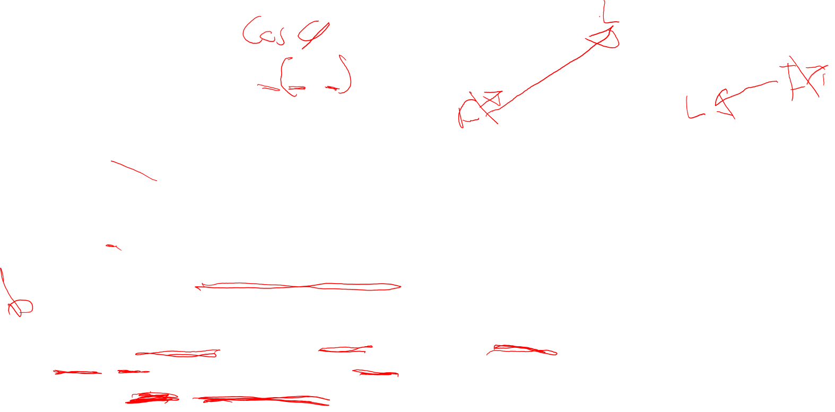

Diffuse Math
$$I_{DP}= k_{d}({\hat{L}}_{m}∙\hat{N})i_{m,d}$$
Diffuse Frag Colour = Diffuse Luminance Constant * (the direction of the light to the surface
DOT
The normal vector of the surface) *Light Diffuse colour

Slide 29

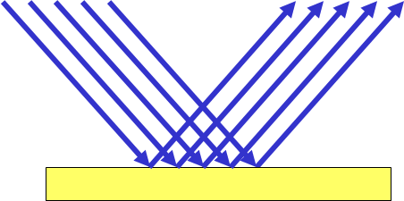

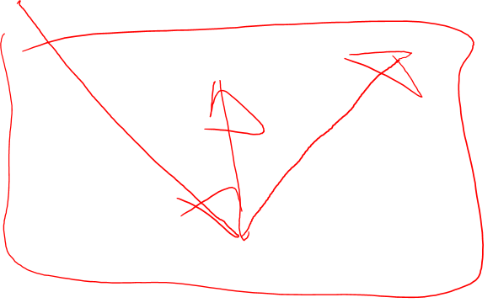

Specular
Perfect reflection, like a mirror.
The angle of incoming light is equal to the angle of reflected light (from the surface normal).
Surface Normal
$$∅$$
$$∅$$
Incoming Light
Specular Reflection

Slide 30
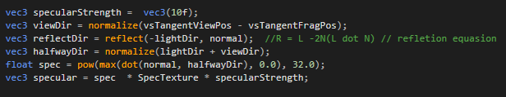
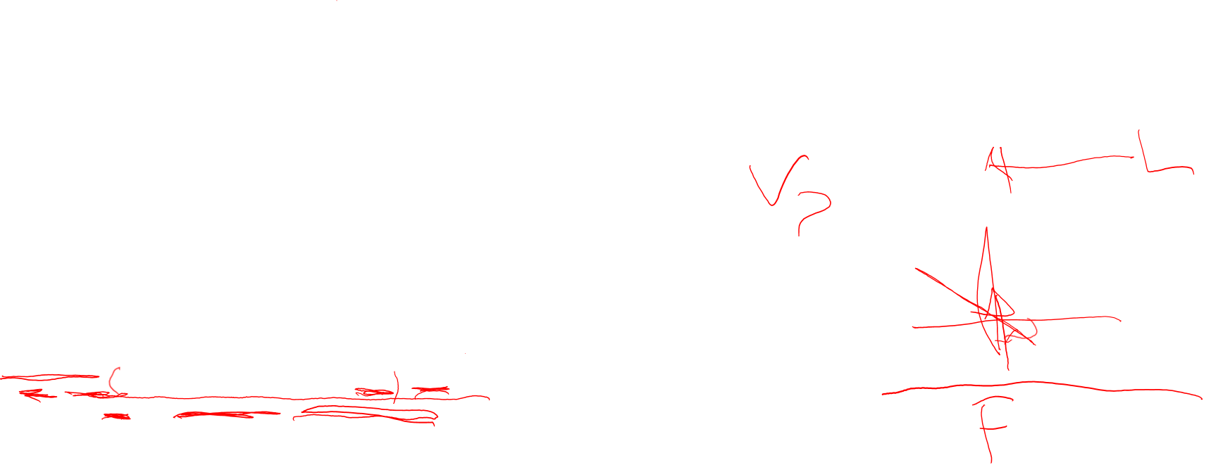

Specular Math
$$I_{SP}= k_{s}{({\hat{R}}_{m}∙\hat{V})}^{α}i_{m,S}$$
Spec Frag Colour = Spec Luminance Constant * (Path of reflected light
DOT
Direction to the viewer) *Light Spec colour

Slide 31
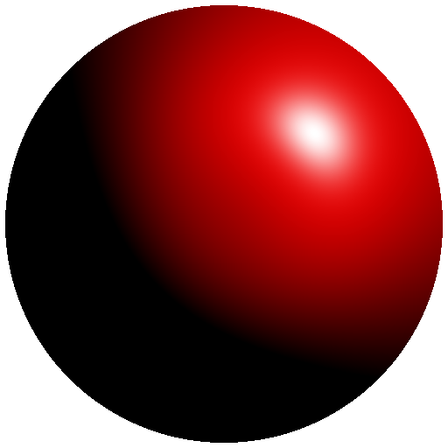
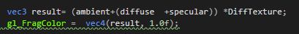
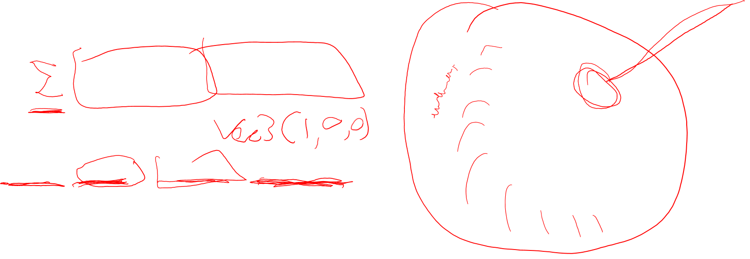

Combining it
$$I_{P}= k_{a}i_{a}+ \sum_{m ∈Lights}{(k_{d}\left({\hat{L}}_{m}∙ \hat{N}\right)i_{m,d}+ k_{s}{({\hat{R}}_{m}∙ \hat{V})}^{α}i_{m,s})}$$

Slide 32
Questions?

